Slide 1
RECIPE FINDER
Vedang Sawarkar- 19BCE1303
Tejas Vaichole – 19BCE1295
Sanika Kulkarni-19BCE1328

Slide 2
Problem statement
Designing a user friendly web application that can list out recipes based upon the ingredients input by the user.
Listing of recipes should be in such a way that recipes at top contain almost all the ingredients input by the user and recipe at the bottom should contain some extra or different ingredients apart from those input by the user.
This app is very apt during this lockdown period as people who are left with minimal ingredients and don’t know what to cook, can find out and explore new recipes in this app.

Slide 3
Description of project
We are designing a web app that can help people find out recipes based on their input ingredients.
Visiting users who wish to find a recipe will have to enter the ingredients that they possess at their home.
The input ingredients will be sent to the backend where an efficient algorithm will run to map the input ingredients with recipes.

Slide 4
After filtering out the recipes, another algorithm will run, that will display the filtered recipes in such a way that recipes displayed at top will contain all the ingredients that are input by the user and recipes at bottom will contain some extra and not easily available ingredients also.
There will be 2 types of users and 1 administrator.
Types of Users -
1) Registered Users
2) Unregistered Users.

Slide 5
For registering, user will have to fill up a signup form.
Registered users will be able to upload their own recipes as well, on the portal for others to view and will also be able to give reviews.
Unregistered users will visit the website and search for recipes. They wont be able to upload their own recipes. If they want to give their reviews, they will have to signup.
Administrator will have to be authenticated while logging in.
Administrator will have rights to upload new recipes and update old recipes.
Administrator will have rights to take down plagiarised recipes.

Slide 6
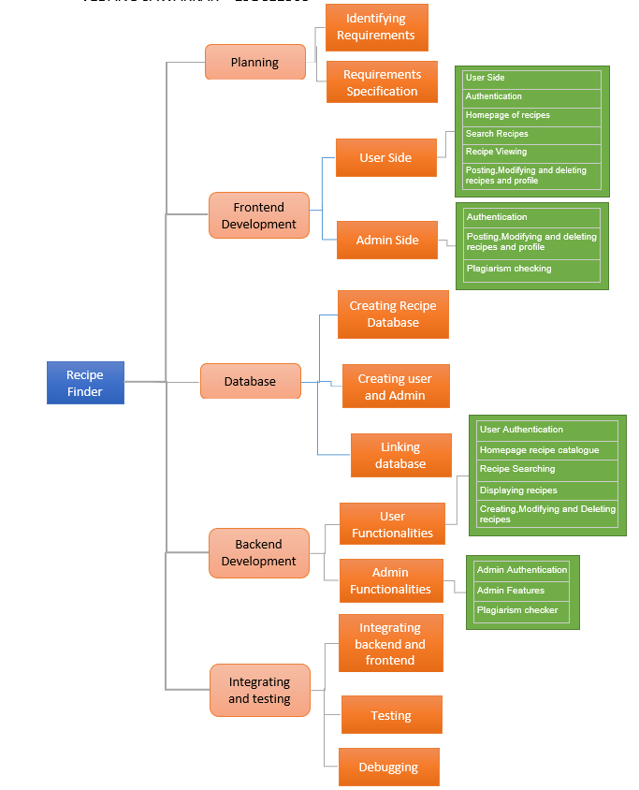
WBS

Slide 7
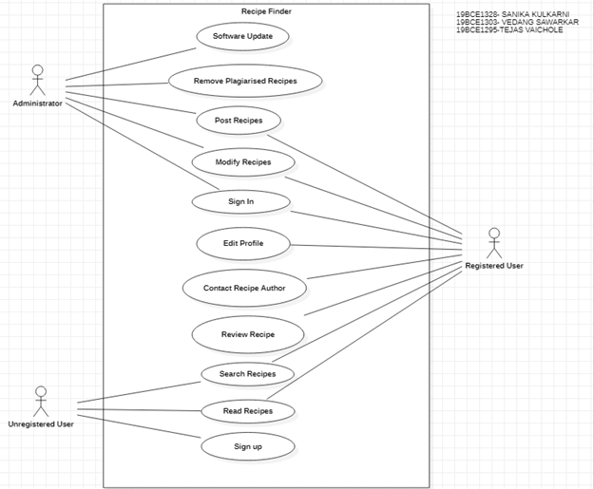
Usacase Diagram

Slide 8
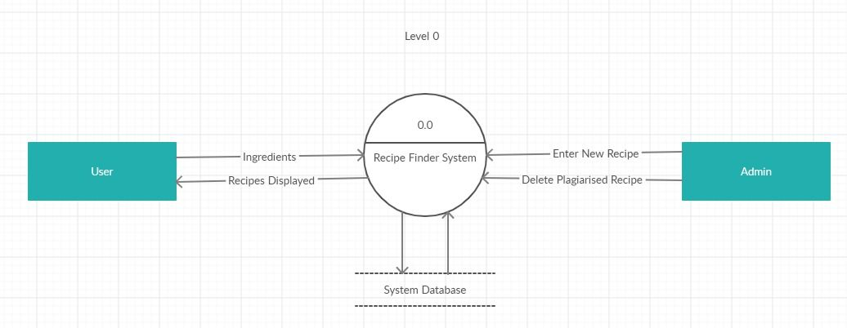
DATA FLOW DIAGRAM

Slide 9
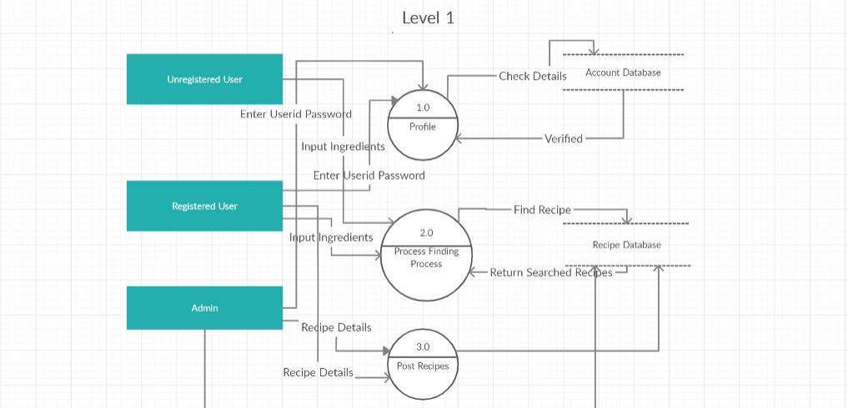

LEVEL 1
DFD
Recipe finding process

Slide 10
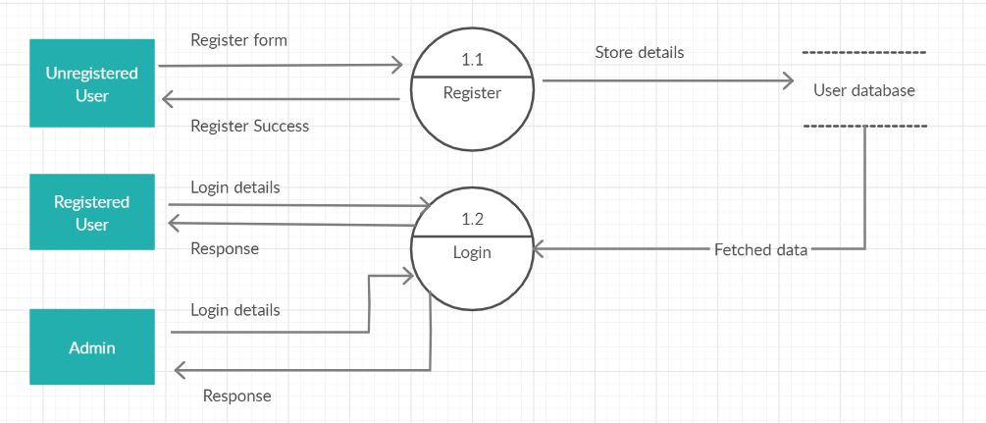
LEVEL 2 DFD

Slide 11
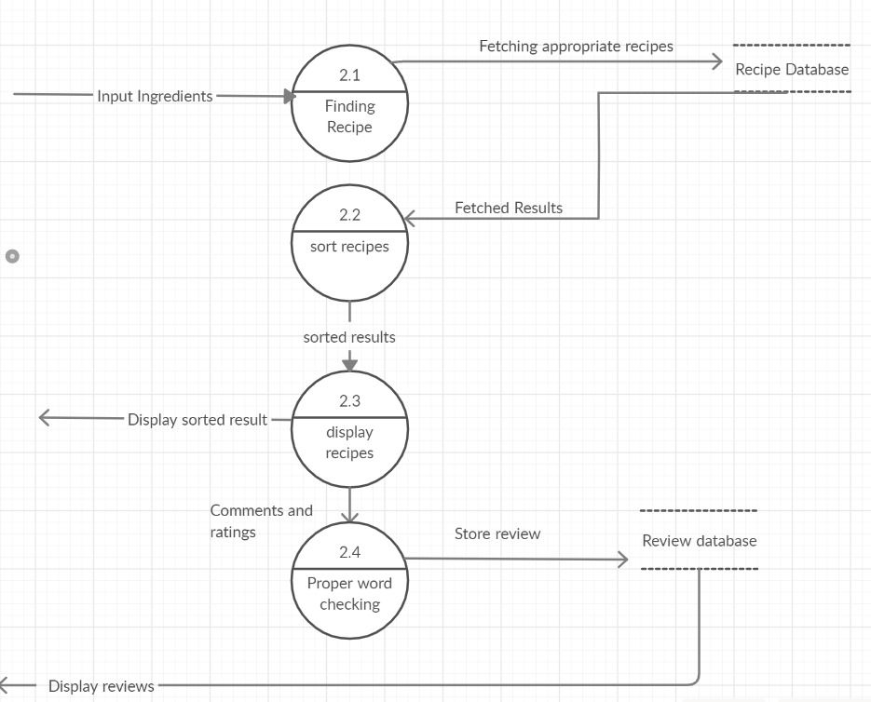

Slide 12
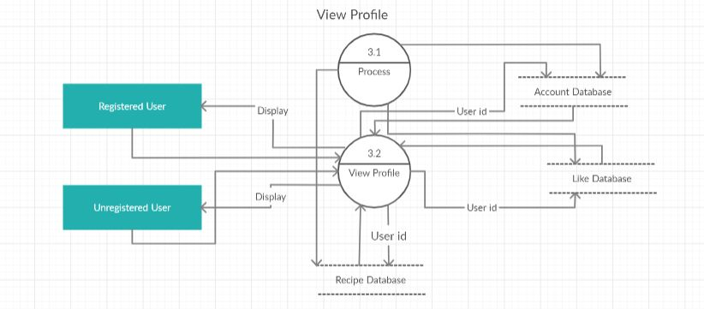
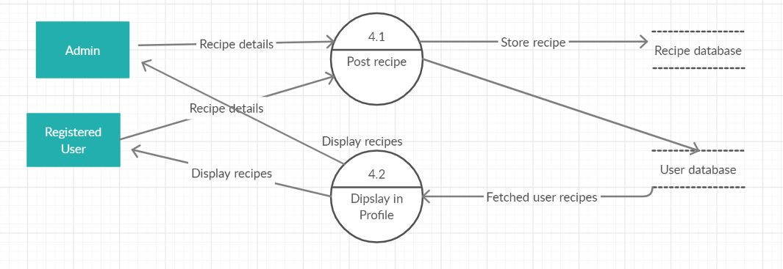
Account Database

Slide 13
THANK YOU

